Slide 1
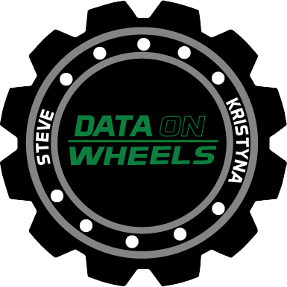
Power BI Meets Programmability
Kristyna Hughes

Slide 2

About Me ~ Kristyna Hughes
Senior data & analytics consultant at 3Cloud, PASS MN Board Member, Lexington Data Technology Group co-organizer , co-author on DataOnWheels, co-founder of Data On Rails
My experience includes implementing and managing enterprise-level Power BI instances, training teams on reporting best practices, learning new coding languages to hack into Power BI, and building templates for scalable analytics.
Check out my blog: https://dataonwheels.wordpress.com/
Check out my blog platform: https://dataonrailsblog.wordpress.com/
Connect on LinkedIn: https://www.linkedin.com/in/kristyna-hughes-dataonwheels/
Connect on Twitter: @HughesKristyna

Slide 3

Trends in Data Spending
In 2015, companies spent an average of $7.4M on data-driven initiatives.
In 2022, that number went up to $12.3M with 55% of executives estimating that budget will increase.
That 40% increase in budget highlights a clear priority on cultivating a data-driven culture

Slide 4

Why are we talking about C#?

Slide 5
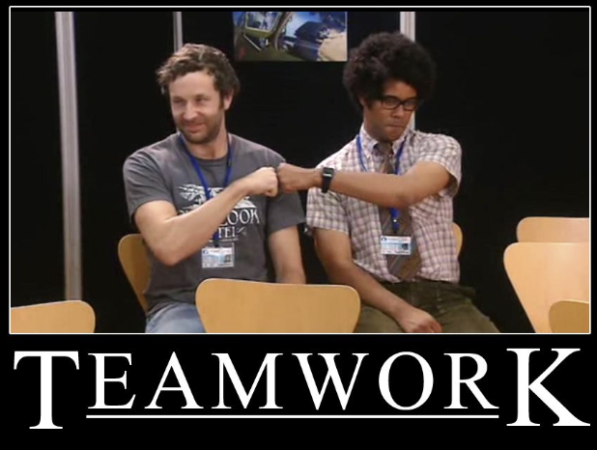
BI & App Dev, Better Together
Scalability
Adaptability
Programmability

Slide 6
Important Terms
Tabular Object Model (TOM) : exposes native tablular metadata objects in order to support programming tabular models (aka Power BI, SSAS, AAS)
Analysis Services : an analytical data engine (VertiPaq) that provides semantic data models for reports and applications (i.e. Power BI, Excel, Reporting Services, etc).
XMLA Endpoint : XML for analysis. Communicates between applications and the Analysis Services engine. Data sent over XMLA is fully encrypted. Requires Power BI Premium or Premium Per User workspace.

Slide 7

Demo Time!

Slide 8

Questions?

Slide 9
Don’t forget to connect, thanks for listening!
LinkedIn: https://www.linkedin.com/in/kristyna-hughes-dataonwheels/
Blog: https://dataonwheels.wordpress.com/
Email: Kristyna@dataonwheels.com
Twitter: @KristynaHughes

